Slide 1
Overview of Cyber Security attacks on source code

Slide 2
Top 5 C++ security risks
C++ offers many powerful capabilities to developers, which is why it’s used in many industries and many core systems. But unlike some higher-level languages that offer less direct control over resources, C++ has a variety of security concerns that developers must be keenly aware of when writing code to avoid introducing vulnerabilities into projects.
As developers, we build applications with our end-users in mind. They trust us with their data, time, and device access. It’s our responsibility to ensure that our application and our users’ data is always safe and secure.

Slide 3
Problems with Memory
Memory related vulnerabilities are very dangerous.
They are often classified as 0-days.
0-days are vulnerabilities in common software leveraged by malware and viruses.
Essential operating system components and programs such as system services, browsers, crypto libraries and document readers are written in C/C++ and are particularly exposed to these types of flaws.

Slide 4
There are many flavours of memory vulnerabilities but we will focus on the most common mistakes:
Buffer Copy without Checking Size of Input — CWE 120
Incorrect Calculation of Buffer Size — CWE 131
Uncontrolled Format String — CWE 134
Off by One — CWE 193

Slide 5
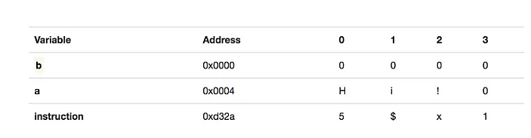
Memory Overflow
Imagine the program uses two variables a and b. The contents and length of variable b are controlled by the user.
Each variable is intended to store 3 characters. At first variable a contains the string “Hi!”.

Slide 6
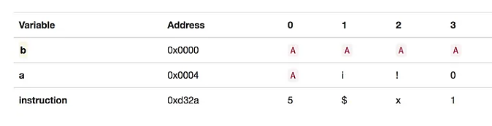
If the user enters the string AAAAA (5 As) for variable b the following will happen.
Variable b only had 3 locations reserved for its value plus one for the string terminator \0 .
By entering 5 characters the user is now writing into space reserved for variable a.

Slide 7
Variables are pointers to memory locations.
The value of b will now become AAAAAi! while the value of a will become Ai!.
If the program outputs the value of b then the attacker will be able to know part of the value of a which is known as a memory leak.

Slide 8
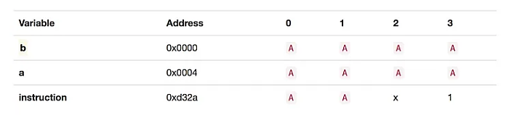
If the user enters a sufficiently long value, they will hit the instruction area and alter the program code.

Slide 9
Memory SafeR Functions
Overflow can be prevented by controlling the number of characters read into the buffer.
This is done using memory safe functions.
It is important to note that simply using these functions will not prevent overflow. They also must be used correctly.

Slide 10
There are several ways to prevent this issue, some of which depend on our compiler or OS and kernel features.
The main tools we can use to secure our data are
  stack canaries,
  address space layout randomization (ASLR),
  data execution prevention (DEP).

Slide 11
Stack canaries add a new, randomly selected secret value to the stack every time a program starts. Before a function returns, this value is verified.
ASLR prevents an attacker from knowing the memory layout, making it challenging to perform the buffer overflow attack. If the attacker doesn’t know where the data resides in memory, they won’t know which buffer to attack.
DEP marks certain memory areas, like the stack, as non-executable memory.

Slide 12
In addition to using OS and compiler features, we must implement good coding practices, including bounds checking.
We should avoid using standard library functions vulnerable to buffer overflow attacks, such as get, strcpy, strcat, scanf, and printf, as they don’t perform bounds checking. Instead, we should replace them with equivalent secure functions, like fgets.

Slide 13
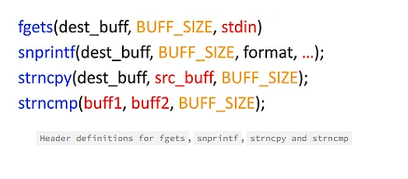
Several functions that allow the program to limit the size of the value read into a buffer: fgets, snprintf, strncpy, strncmp

Slide 14
1. Buffer overflow
One of the most common security concerns with C++ is a buffer overflow.
Buffer overflows are caused by not having built-in boundary check features in C++, which reduce the risk of overwriting memory.
Writing outside our allocated memory can cause program crashes and corrupt data.
It can even lead to the execution of malicious code.
As a result, buffer overflow ranked as the most dangerous software weakness in the 2021 CWE Top 25 Most Dangerous Software Weaknesses survey.

Slide 15
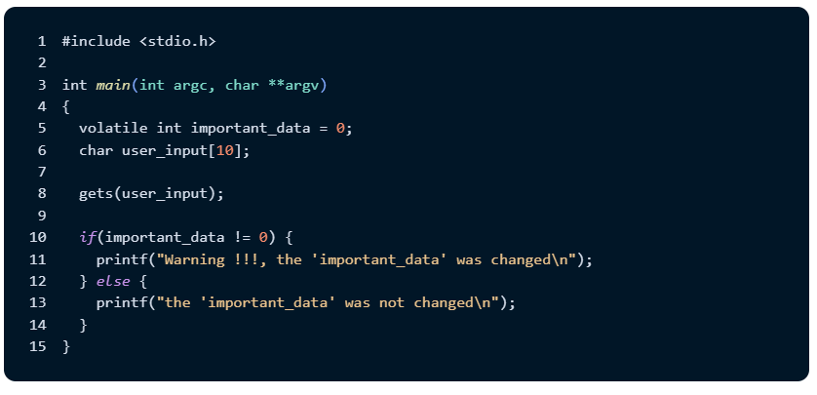
1. Buffer overflow (Cont.,)
In the following code snippet, we get user input using the gets function and check to see if it affected the important_data variable.
While this code may look innocent, it’s vulnerable to a buffer overflow attack if the user enters a string longer than the length of the user_input array. The stack is growing towards a lower address, meaning that the important_data is under the user_input in the memory.

Slide 16
1. Buffer overflow (Cont.,)
There are several ways to prevent this issue, some of which depend on our compiler or OS and kernel features. The main tools we can use to secure our data are stack canaries, address space layout randomization (ASLR), and data execution prevention (DEP).
  Stack canaries add a new, randomly selected secret value to the stack every time a program starts. Before a function returns, this value is verified.
  ASLR prevents an attacker from knowing the memory layout, making it challenging to perform the buffer overflow attack. If the attacker doesn’t know where the data resides in memory, they won’t know which buffer to attack.
  DEP marks certain memory areas, like the stack, as non-executable memory.

Slide 17
1. Buffer overflow (Cont.,)
In addition to using OS and compiler features, we must implement good coding practices, including bounds checking.
We should avoid using standard library functions vulnerable to buffer overflow attacks, such as get, strcpy, strcat, scanf, and printf, as they don’t perform bounds checking.
Instead, we should replace them with equivalent secure functions, like fgets.

Slide 18
2. Integer overflow and underflow
Integer overflow is when the value we’re trying to store in an integer variable exceeds the maximum value an integer can hold.
Integer underflow occurs when this value is less than the minimum value an integer can hold. When it’s less, the value wraps around.
The 2021 CWE Top 25 Most Dangerous Software Weaknesses survey ranked this the 12th most dangerous software weakness.
Additionally, integer overflow and underflow can lead to a buffer overflow vulnerability.

Slide 19
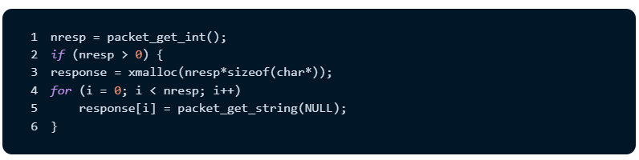
2. Integer overflow and underflow (Cont.,)
The following code is an actual bug found in OpenSSH v3.3 and is an example of how an integer overflow bug that can cause a buffer overflow attack:

Slide 20
2. Integer overflow and underflow (Cont.,)
This code represents an integer overflow vulnerability. While the code checks for a zero value, it’s possible to have a zero-memory allocation if the input nresp equals 1073741824.
Multiplying this value with four (size of char pointer) causes the variable to overflow, and xmalloc(nresp*sizeof(char*)) allocates a buffer of size 0.
To mitigate this vulnerability, we should practice range checking for zero/the minimum value and the maximum value to protect against overflow or wrapping of the variable value.

Slide 21
3. Pointer initialization
Pointer initialization is critical. We can expose a lot of data using a pointer that’s not initialized as a pointer to a memory location or function.
If the uninitialized pointer points to a memory location, it can cause the program to read or write to an unexpected memory location.
If it points to a function, it can cause the unintentional execution of an arbitrary function.

Slide 22
3. Pointer initialization (Cont.,)
Pointers are also vulnerable to null pointer dereferencing attacks, which can lead to program reliability issues.
Pointer dereferencing attacks describe accessing a pointer while initialized to null, causing an undefined behavior (UB) in the program. And, in most cases, it will crash.
An attacker can take advantage of this by enforcing a null pointer dereference. Incorrectly initializing the pointer will create unexpected and unpredictable behavior.
An attacker can bypass some security checks or reveal debugging information that they can use later.

Slide 23
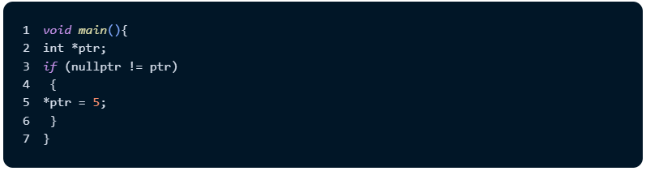
3. Pointer initialization (Cont.,)
Let’s look at an example of pointer dereferencing caused by improper pointer initialization:

Slide 24
3. Pointer initialization (Cont.,)
As we can see, the pointer is left uninitialized, which means that a random value is assigned to it, and the check will pass as it may be a non-null value.
We shouldn’t depend only on the checks or the error exception handling to avoid pointer dereferencing attacks.
We should consider not using a pointer if we can avoid them and use references instead. If we do use pointers, we should use smart pointers as a replacement for raw pointers.
Another alternative to pointers is to adapt the Resource Acquisition Is Initialization (RAII) technique in our implementation, which guarantees that a resource is available to any function with access.

Slide 25
4. Incorrect type conversion
Another common vulnerability is incorrect type conversion.
Most issues related to type conversion happen by signed to unsigned conversion, which usually occurs during function calls by passing the wrong parameter type.
Another common vulnerability is type conversion when converting from longer datatypes like double to float and from long int to int, which causes the data to be lost during the implicit conversion.

Slide 26
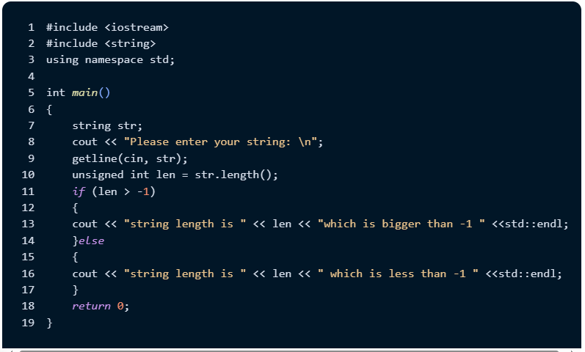
4. Incorrect type conversion (Cont.,)
Here’s a simple example of what an incorrect type conversion vulnerability looks like:

Slide 27
4. Incorrect type conversion (Cont.,)
While it seems impossible to hit the else statement, as any input string length will be larger than -1, this code doesn’t work and always hits the else statement.
According to the C++ standard and the integral promotion concept, if two values of different data types are compared, the representation of the values will be changed.
In our case, signed short int’s value will be cast to the larger type, unsigned int. This will convert the -1 value to an unsigned integer value, equal to 4294967295, which will cause the program flow to go to the else statement.

Slide 28
4. Incorrect type conversion (Cont.,)
The same issue can happen if you use unsigned integers for subtracting two input values from the user, assuming that the user will never enter a smaller value first, leading to the result of the subtraction being negative.
According to the Google C++ Style Guide, avoiding doing math with unsigned integers can mitigate most of the type conversion problems (except for representing bitfields).
They also recommend avoiding the mix between signedness and using Iterators and containers instead of pointers and sizes.

Slide 29
5. Format string vulnerability
There are two components in a format string vulnerability: the format function and the format string.
Before exploring format string vulnerabilities, let’s review what the format function and the format string do.
The format function is the function that converts variables of the programming language into a human-readable format.
Examples of the format function are printf and fprintf.

Slide 30
5. Format string vulnerability (Cont.,)
The format string is the argument of the format function, which contains text and format string parameters. Let’s look at an example:
"This is a test text of number: %d ", 11" is the format string.
"%d" is the format string parameter that defines the conversion format.

Slide 31
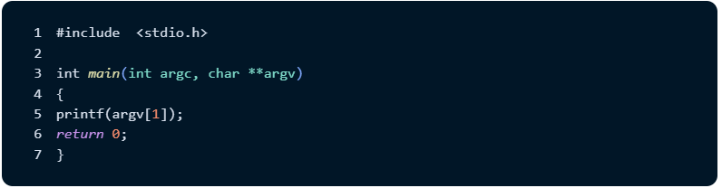
5. Format string vulnerability (Cont.,)
Format string attacks happen when we don’t check the parameters that pass to the format function. For example, assume we implemented an application like the following:

Slide 32

5. Format string vulnerability (Cont.,)
This code is vulnerable to the format string attack because it doesn’t check the user input. So, the attack happens by passing a format string parameter and input like this:
This input can get data from the stack, as the program output is something like the following:

Slide 33
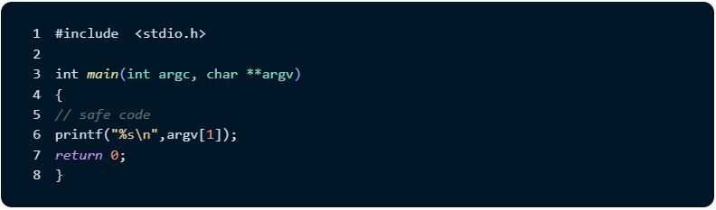
5. Format string vulnerability (Cont.,)
This output is caused by printf treating %p as a reference to a void pointer that’s trying to interpret the memory addresses.
To prevent this vulnerability, we need to add a format argument to our code, as shown below:

Slide 34

5. Format string vulnerability (Cont.,)
The code snippet above is safe because it won’t interpret the string. For example, if we tried to compile and run the code, the output would be as follows:

Slide 35
5. Format string vulnerability (Cont.,)
The output is only the characters passed to the program without interpretation as a reference to the void pointer.
Another better solution is to avoid the usage of printf whenever possible unless you are forced to use it, and instead replace it with std::format and std::vformat (introduced in C++ 20), as it verifies the input against the types either on the runtime or in compile time and raise a format_error on mismatch.

Slide 36
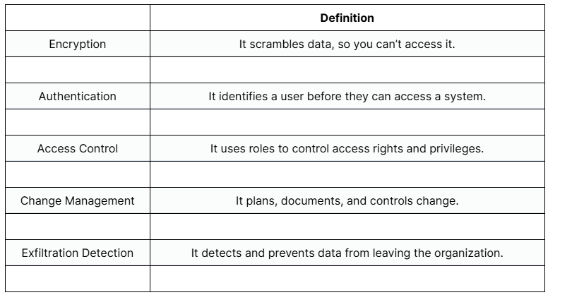
Protecting Source Code

Slide 37
Security Vulnerabilities
Security vulnerabilities in C++ programming languages can be classified as follows:
1. Integer vulnerability
2. Buffer overflow
3. String vulnerability
4. Pointer subterfuge

Slide 38
Ways to detect Security Vulnerabilities
There are two ways of detecting security vulnerabilities in a program.
Static Analysis is carried out statically without executing the code. In this method, the tool inspects input program code for possible security vulnerabilities and alerts the user.
Dynamic Analysis is carried during the execution of a program. Dynamic analyzer monitors system memory, functional behavior, response time, and overall performance of the program to find security vulnerabilities

Slide 39
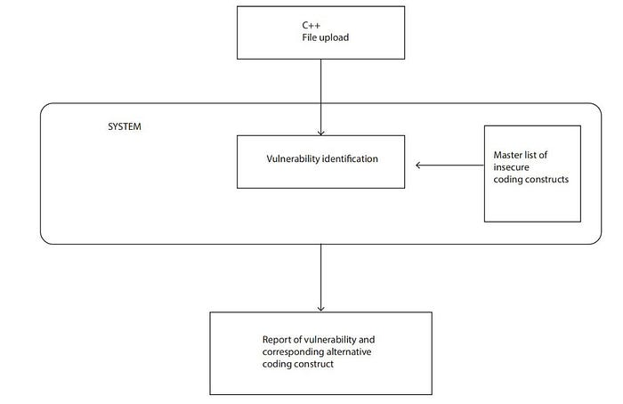
Ways to detect Security Vulnerabilities (Cont.,)

Slide 40
Using cppcheck & flawfinder for C & C++ Static Analysis

Slide 41
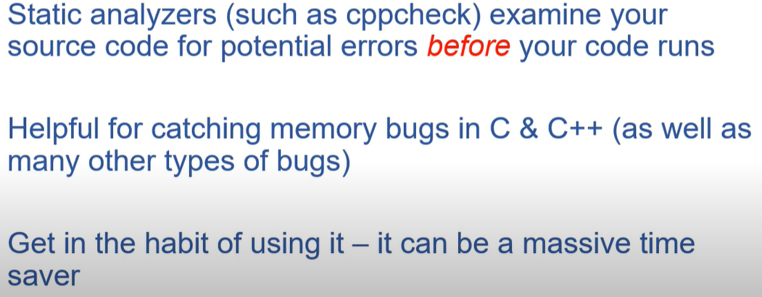
Static code analysis

Slide 42
Commonly-occuring classes of memory-related bugs in C/C++.
Memory Leaks: memory is allocated but not deallocated, causing the program to consume more and more memory over time
Dangling Pointers: a pointer to a memory location that has already been freed explicitly or by a garbage collector
Buffer Overflows: write to a memory buffer beyond its allocated bounds, causing the program to crash or behave unexpectedly
Use After Free: memory access that has already been freed, causing the program to crash or corrupt memory
Invalid Free: attempt to free memory that has not been dynamically allocated
Double Free: program attempts to free memory that has already been freed
Notes:
https://github.com/binjamil/alzheimers

Slide 43
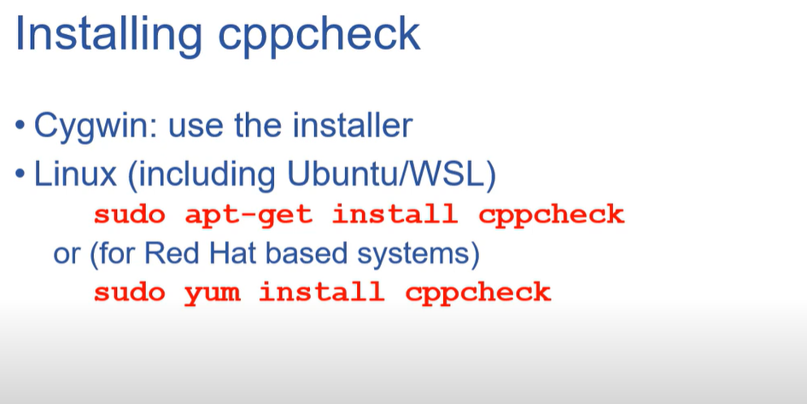

Slide 44
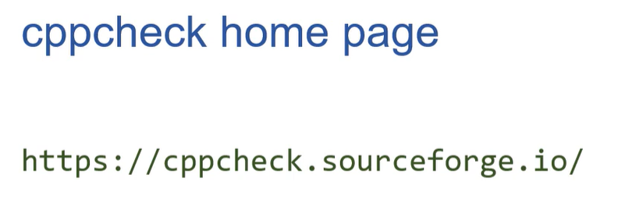

Slide 45
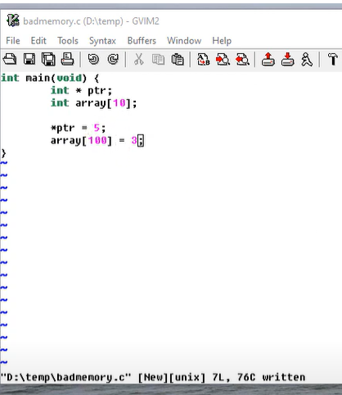
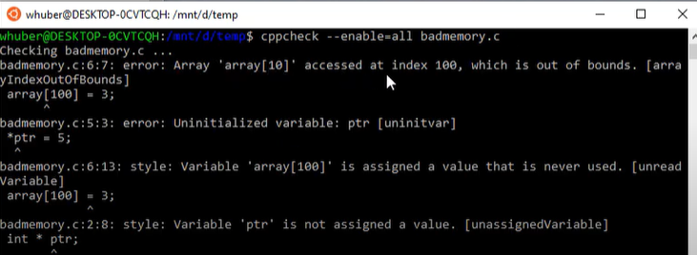

Slide 46
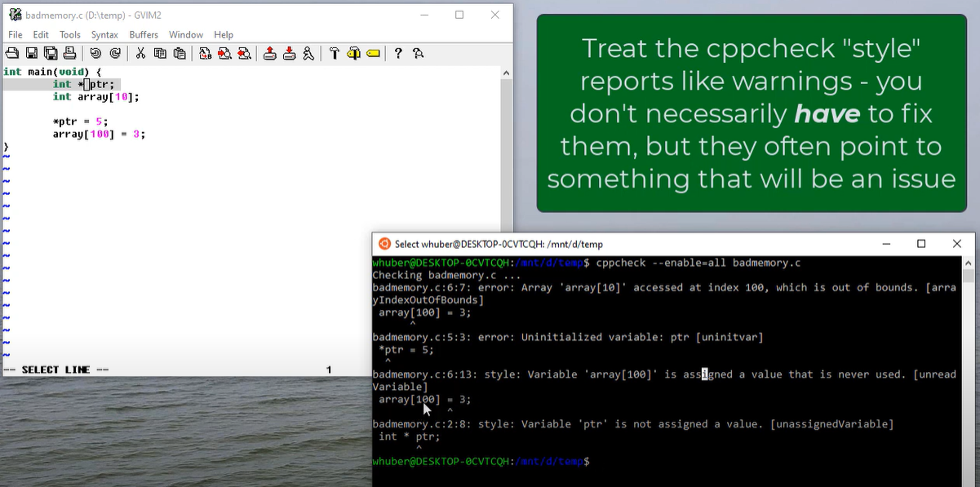

Slide 47
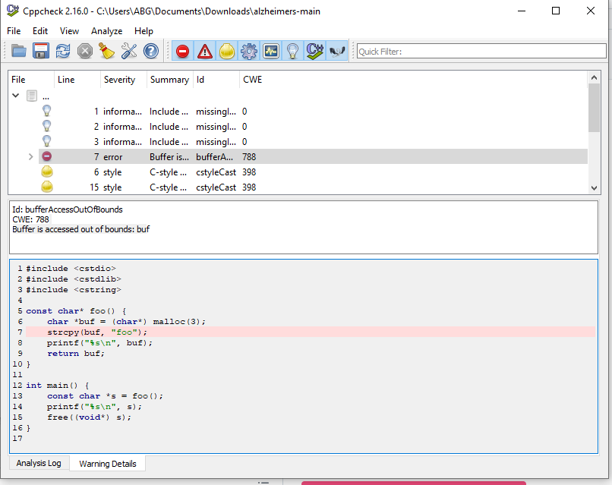

Slide 48
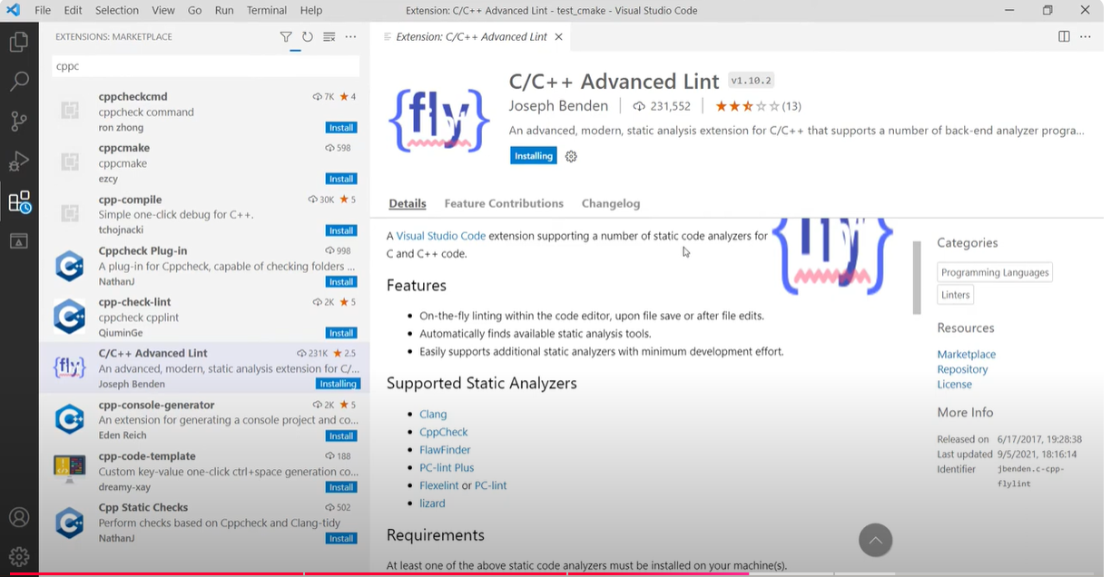

Slide 49
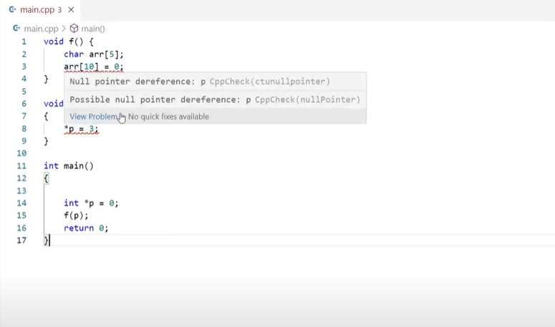

Slide 50
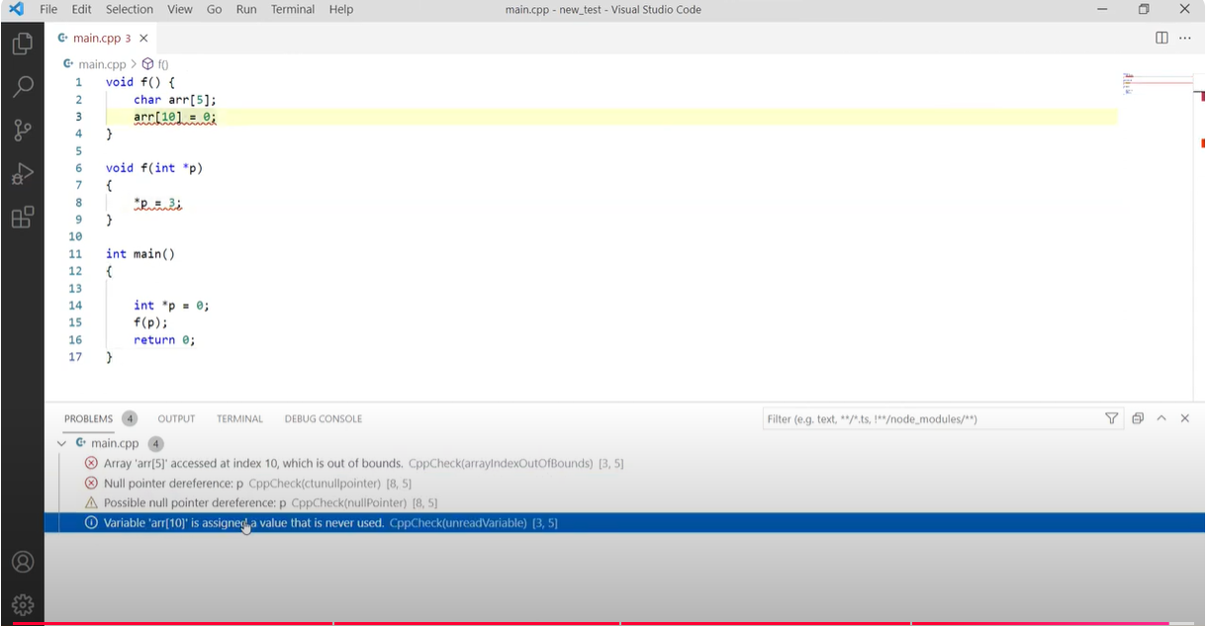

Slide 51
Flawfinder
Flawfinder is a simple program that scans C/C++ source code and reports potential security flaws.
It can be a useful tool for examining software for vulnerabilities, and it can also serve as a simple introduction to static source code analysis tools more generally.
It is designed to be easy to install and use.
Flawfinder supports the Common Weakness Enumeration (CWE) and is officially CWE-Compatible.

Slide 52
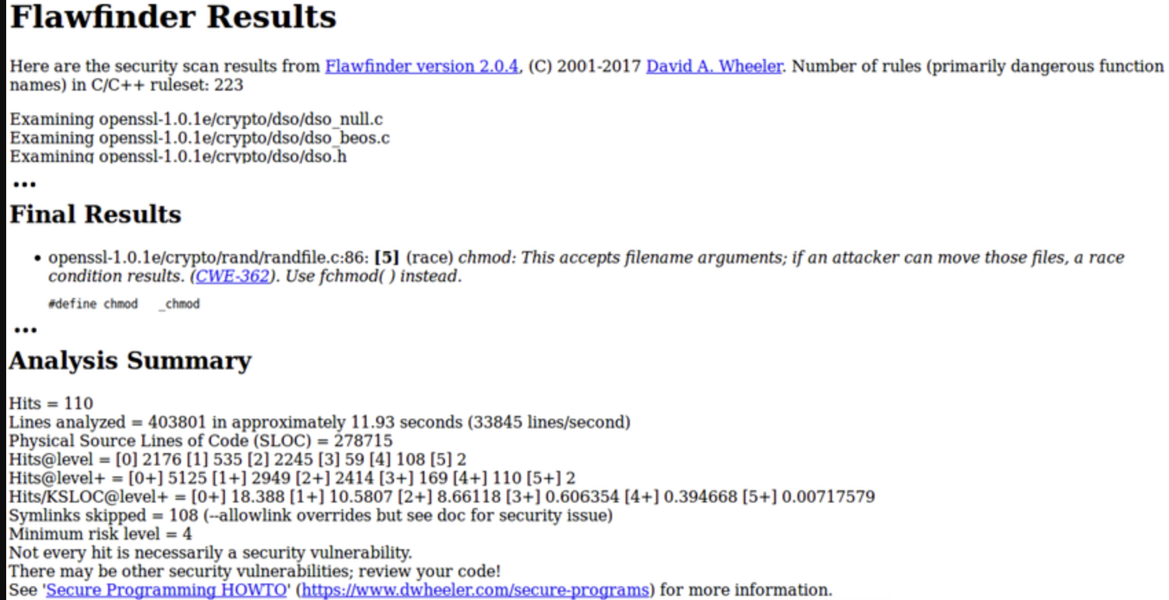

Slide 53
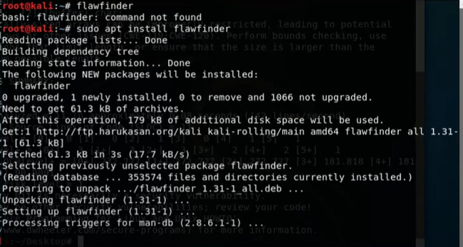

Slide 54
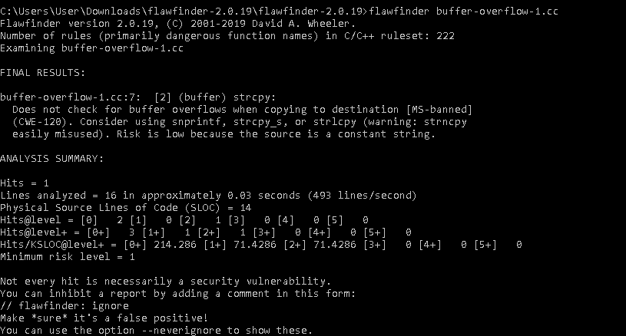

Slide 55
C++ has inherent safety and security challenges because of its low-level capabilities:
• Memory Management: Manual memory management (via new/delete) and direct memory access (via pointers) expose C++ code to security risks like buffer overflows, double-free errors, and memory leaks.
• Undefined Behaviour (UB): UB in C++ can lead to unpredictable behaviour, posing both safety and security risks. If not carefully managed, UB can be exploited by attackers to perform malicious actions or destabilize the application.
• Concurrency Issues: Lack of proper synchronization when using multiple threads can lead to data races and inconsistencies, which compromise both safety and security.

Slide 56
Best Practices for C++ Cyber Security
The following best practices assist you in securing your C++ code and detecting potential security threats, vulnerabilities, and malware attacks, ensuring your code is cleaner.
Prevent buffer overflow: You need to utilize std::string and std::vector for memory management automation and bonus checking, decreasing the risk of buffer overflows. Also, avoid strcpy and strncpy can lead to buffer overflows if not used properly.
Error handling and logging: C++ can efficiently manage unexpected conditions like invalid input and resource exhaustion. It can provide structure in that way, which helps to handle errors and propagate them.

Slide 57
Best Practices for C++ Cyber Security (Cont.,)
Choose modern C++ features: Adding modern features like RAII and employing range-based loops can ensure automated resources and decrease the risk of memory leaks and potential terror threats. Use smart pointers like std::unique_ptr and std::shared_ptr to handle objects and prevent memory leaks.
RAII and secure standard libraries: Setting standard libraries and algorithms like std::hash for hashing and std::random_device can help secure and handle data structure efficiently. Also, evaluate carefully and determine secure third-party libraries for particular tasks.
Utilize static analysis tools and regular updates: Implementing tools like Clang’s static analyzer, Veracode, and Coverity can detect potential security vulnerabilities in your code. Ensure your libraries, tools, and compilers are updated to maximize your advantage from security patches and improvements.

Slide 58
Strategies to Mitigate C++ Safety and Security Issues
Use Modern C++ Features: Modern C++ (C++11 and beyond) provides safer memory management options (e.g., std::unique_ptr, std::shared_ptr) and threading utilities (std::thread, std::mutex, std::atomic) that help prevent common errors.
Static Analysis Tools: Tools like Clang-Tidy, Cppcheck, and Coverity can detect security vulnerabilities and potential safety issues in C++ code.
Runtime Safety Checks: AddressSanitizer, ThreadSanitizer, and UndefinedBehaviorSanitizer can catch many safety issues during development
Use Safer Libraries: Libraries like the C++ Standard Library and Boost offer data structures and algorithms with built-in safety checks and well-tested implementations.

